Slide 1
COCA Call Information
For the best quality audio, we encourage you to use your computer’s audio.
Webinar link: https://zoom.us/j/209471168
If you cannot join through digital audio, you may join by phone in listen-only mode:
US: 1(646) 876-9923 or 1(669) 900-6833
Webinar ID: 209 471 168
All questions must be submitted through the webinar system via the Q&A button. Please do not ask a question using the chat button.

Slide 2
2019-2020 Influenza Season Update and Recommendations for Clinicians
Clinician Outreach and Communication Activity (COCA) Webinar
Tuesday, January 28, 2020

Slide 3
Continuing Education
All continuing education for COCA Calls are issued online through the CDC Training & Continuing Education Online system at https://tceols.cdc.gov/
Those who participated in today’s COCA Call and who wish to receive continuing education should complete the online evaluation by March 2, 2020, with the course code WC2922. The access code is COCA012820. Those who will participate in the on demand activity and wish to receive continuing education should complete the online evaluation between March 2, 2020, and March 3, 2022, and use course code WD2922. The access code is COCA012820.
Continuing education certificates can be printed immediately upon completion of your online evaluation. A cumulative transcript of all CDC/ATSDR CEs obtained through the CDC Training & Continuing Education Online System will be maintained for each user.

Slide 4
Continuing Education Disclaimer
In compliance with continuing education requirements, CDC, our planners, our presenters, and their spouses/partners wish to disclose they have no financial interests or other relationships with the manufacturers of commercial products, suppliers of commercial services, or commercial supporters.
Planners have reviewed content to ensure there is no bias.
The presentation will not include any discussion of the unlabeled use of a product or a product under investigational use, except Dr. Angela Campbell would like to disclose that she will discuss the off label use of antiviral medications for treatment of influenza.
CDC did not accept commercial support for this continuing education activity.

Slide 5
To Ask a Question
Using the Webinar System
Click on the Q&A button in the Zoom webinar system.
Type your question in the Q&A box.
Submit your question.
Please do not submit a question using the chat button.
For media questions, please contact CDC Media Relations at
404-639-3286 or send an email to media@cdc.gov.
If you are a patient, please refer your questions to your healthcare provider.

Slide 6
Objectives
Describe the current status of influenza activity in the United States.
Describe the circulating influenza viruses detected this season and explain the implications for clinicians.
Describe antiviral testing and treatment recommendations for patients with suspected and confirmed influenza.

Slide 7

Today’s First Presenter
Alicia P. Budd, MPH Epidemiologist Influenza Division National Center for Immunization and Respiratory Diseases Centers for Disease Control and Prevention

Slide 8

Today’s Second Presenter d
Angela J. P. Campbell, MD, MPH Medical Officer Influenza Division National Center for Immunization and Respiratory Diseases Centers for Disease Control and Prevention

Slide 9
2019–2020 Influenza Season Update and Recommendations for Clinicians, United States

Slide 10

2019–20 Influenza Season Activity

Slide 11
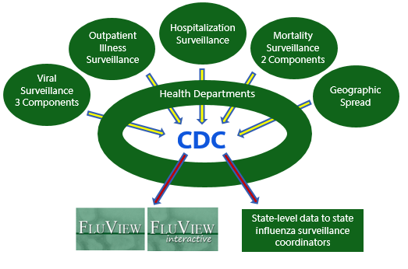
U.S. Influenza Surveillance System

Slide 12
Goals of Influenza Surveillance
Identify and characterize viruses/strains
Identify viruses with pandemic potential
Provide situational awareness
Describe the onset and duration of the season
Track geographic spread
Monitor severity
Describe clinical infections and those at risk
Guide decisions for interventions
3

Slide 13

Influenza Positive Tests Reported to CDC by U.S. Clinical and Public Health Laboratories, Sept. 29, 2019 – Jan. 18, 2020
Clinical Laboratories
Season totals
Public Health Laboratories
A/H1 – 37%
A/H3 – 6%
B/Vic – 55%
B/Yam – 1%

Slide 14
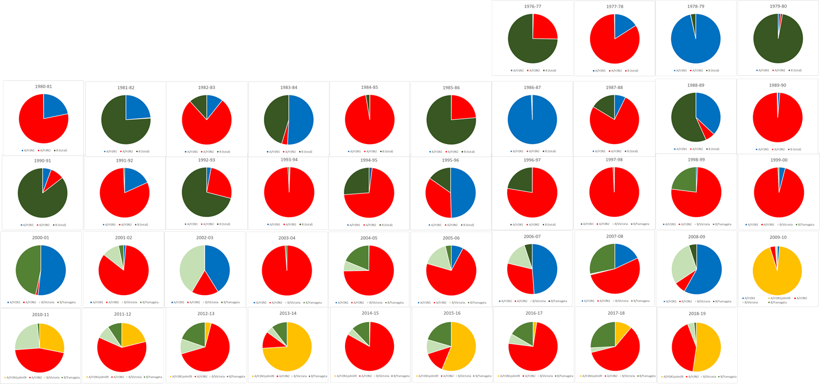

Proportion of Circulating Viruses by Season United States, 1976-1977 to 2019-2020*
Late 1970s
1980s
1990s
2000s
2010s
* Through week 3, as of January 18, 2020

Slide 15
Proportion of Circulating Viruses by Season United States, 1976-1977 to 2019-2020*
Late 1970s
1980s
1990s
2000s
2010s
* Through week 3, as of January 18, 2020

Slide 16
Proportion of Circulating Viruses by Season United States, 1976-1977 to 2019-2020*
Late 1970s
1980s
1990s
2000s
2010s
* Through week 3, as of January 18, 2020

Slide 17
History – B lineages
Early/mid 1980s – separate B lineages identified
1988 - B/Yamagata/16/88 identified by Japan and then retrospectively (earlier in 1980s) identified from other countries in Asia
Sequence analysis of early Yamagata viruses showed there were related to a 1983 virus (B/USSR/100/83)
1988-1989 season - all US influenza B viruses were antigenically like B/Victoria/2/87
1990-1991 - first B/Yamagata season for the US
B/Yamagata dominated the Bs in circulation in US during 1990s
2001-2002 – B/Victoria virus circulation in US again (1st since 1988-1989)
Since then – cocirculation of Victoria and Yamagata viruses in US

Slide 18
Timing of A and B Circulation
A(H1N1) & B/Vic
A first, then B
A(H1N1) & B/Yam
A & B Simultaneously
A(H1N1)pdm09 & B/Vic
B first, then A

Slide 19
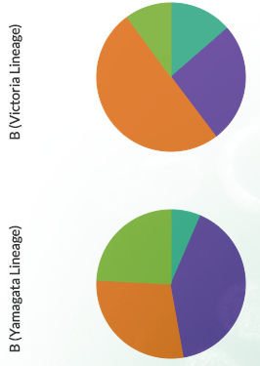





Distribution of B/Victoria and B/Yamagata by Age Group, 2015-16 through 2019-20*
0-4yo: ~15%
School age kids: ~50%
Adults: ~25%
65+: ≤ 10%
0-4yo: ~6%
School age kids: 25-35%
Adults: 34-41%
65+: 23-34%
2015-2016
2016-2017
2017-2018
2018-2019
2019-2020
* Through week 3, as of January 18, 2020

Slide 20
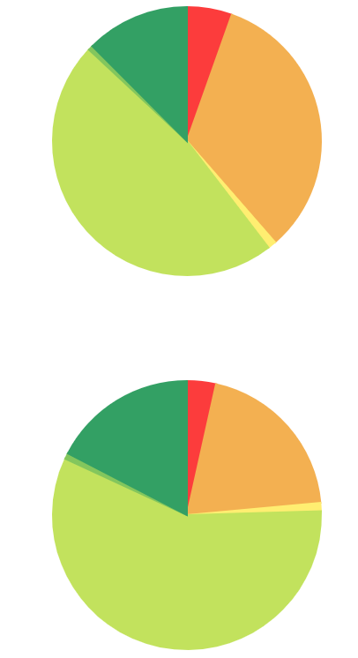

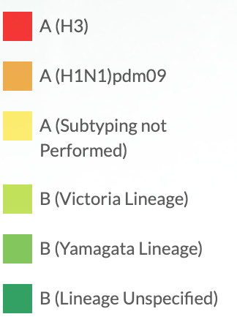
Virus Distribution by Age Group, 2019-2020* Season
0-4 years
25-64 years
B/Victoria predominant
A/H1N1pdm09 predominant
5-24 years
65+ years
* Through week 3, as of January 18, 2020

Slide 21
Influenza A Activity Increasing
Percent A Positivity
Relative Proportion of A(H1N1)pdm09

Slide 22
Virus Characterization: U.S. Viruses Collected September 29, 2019 – January 18, 2020
Public Health Laboratories - Season totals as of 1/18/2020
Virus Subtype or Lineage | Genetic Characterization |  |  | Antigenic Characterization
 | Total No. of Subtype/Lineage Tested | Clade/Subclade | Number (% of subtype/lineage tested) | Number (%) Similar to Cell Grown Vaccine Reference Virus*
A/H1 | 340 |  |  | 74 (100%)
 |  | 6B.1A | 340 (100%)
A/H3 | 268 |  |  | 53 (42%)
 |  | 3C.2a1 | 260 (97.0%)
 |  | 3C.3a | 8 (3.0%)
B/Victoria | 433 |  |  | 88 (60%)
 |  | V1A.1 | 38 (8.8%)
 |  | V1A.3 | 395 (91.2%)
B/Yamagata | 46 |  |  | 10 (100%)
 |  | Y3 | 46 (100%)
A/H1 – 37%
A/H3 – 6%
B/Vic – 55%
B/Yam – 1%
>99% of virus tested are susceptible to 4 licensed antiviral medications.
* Trivalent vaccines will contain an A/Brisbane/02/2018 (H1N1)pdm09–like virus, an A/Kansas/14/2017 (H3N2)–like virus, and a B/Colorado/06/2017–like virus (Victoria lineage). Quadrivalent vaccines will contain the same three HA antigens as trivalent vaccines, plus a B/Phuket/3073/2013–like virus (Yamagata lineage).

Slide 23
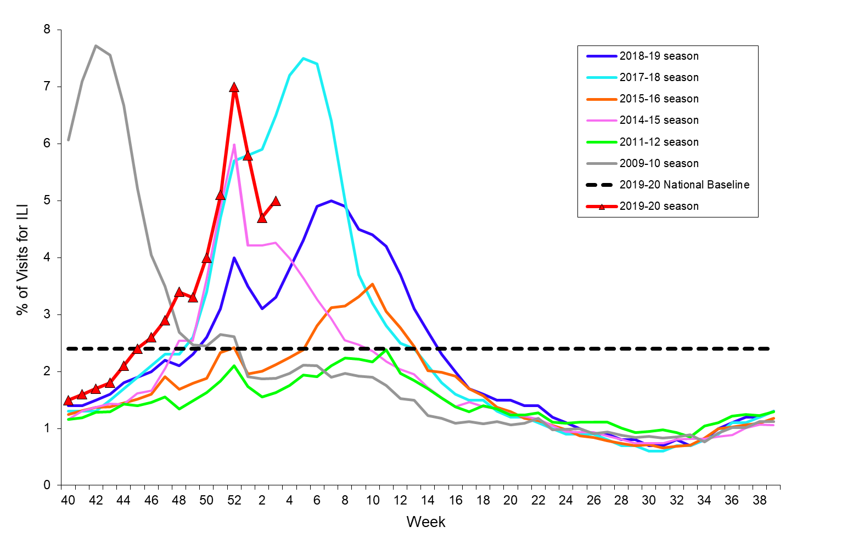
Percentage of Visits for Influenza-like Illness (ILI), 2019-2020 and Selected Previous Seasons

Slide 24
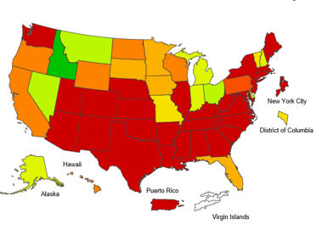
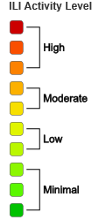
ILI Activity Level Indicator Determined by Data Reported to ILINet, Week 3 ending Jan. 18, 2020

Slide 25
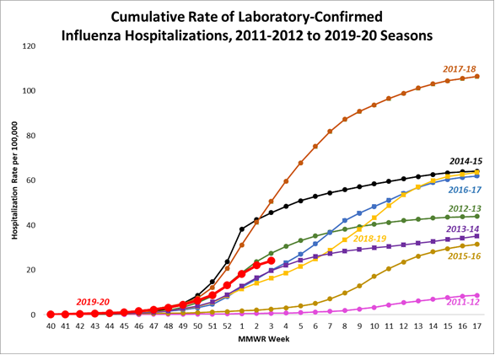
Laboratory Confirmed Influenza Associated Hospitalizations, Cumulative Rate per 100,000; 2011-2012 to 2019-20 Seasons
Age Group | 2019-2020 Season Cumulative Rate per 100,000 Population
Overall | 24.1
0-4 years | 40.6
5-17 years | 10.8
18-49 years | 13.9
50-64 years | 28.9
65+ years | 58.1

Slide 26
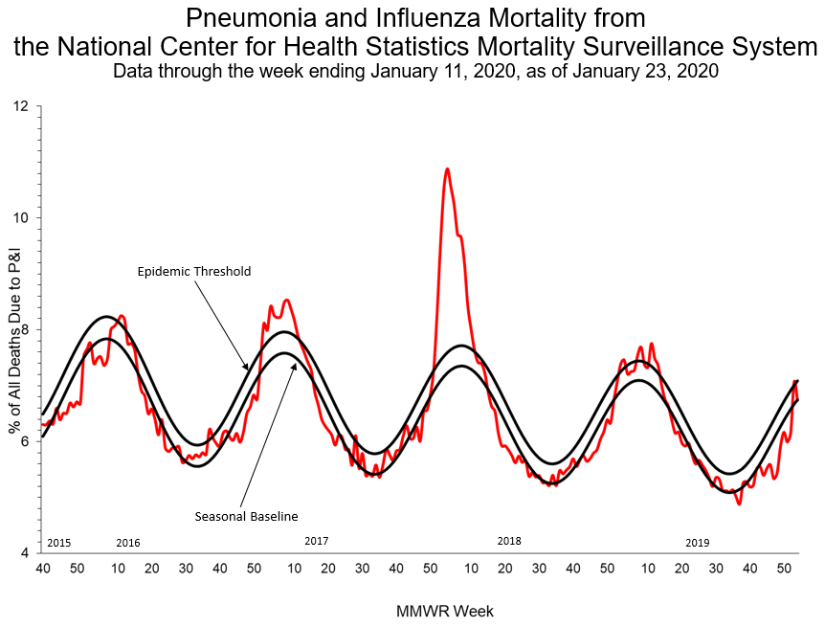
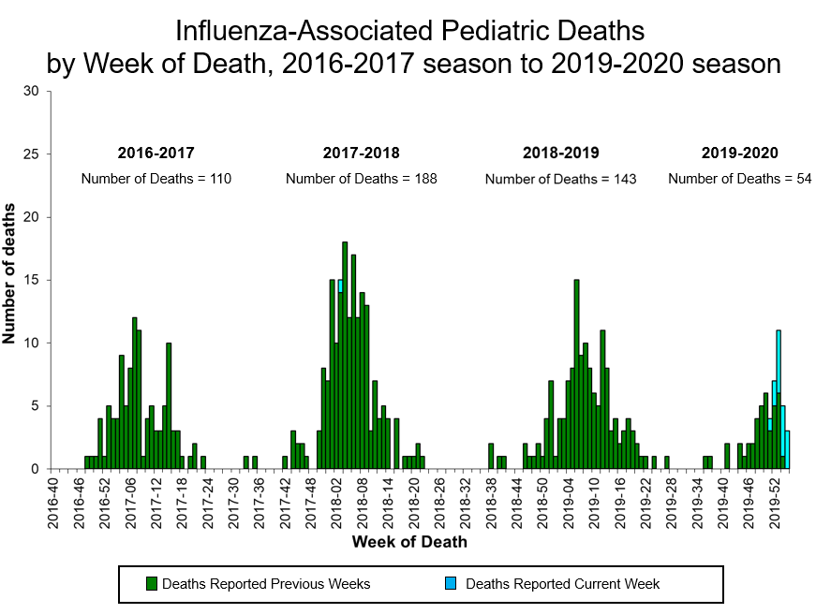
Mortality Surveillance: 2019-2020 and Previous Seasons
Pneumonia and Influenza Mortality, National Center for Health Statistics
Deaths in Children with Laboratory Confirmed Influenza, as of 1/18/2020

Slide 27
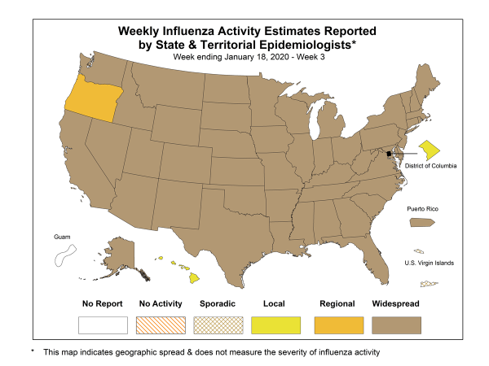
Weekly Influenza Activity Estimates

Slide 28
Burden of Influenza in the United States
2010-11 through 2017-18
2019-20 as Jan.18, 2020
Illnesses: 9.3 – 45 million
Deaths: 12,000 – 61,000
8,200 – 20,000 deaths
Hospitalizations: 140,000 – 810,000
140,000 – 250,000 hospitalizations
15 – 21 million illnesses

Slide 29
Summary: 2019-2020 Influenza Season Activity*
Indicators that track influenza activity are high.
Estimate is at least 15 million illnesses so far.
Indicators that track severity (hospitalizations & deaths) are not high at this point.
Even so, estimates are at least 140,000 hospitalizations and 8,200 deaths so far.
Influenza activity is expected to remain elevated for many more weeks.
Nationally, B/Victoria viruses are predominant this season but during recent weeks approximately equal numbers of A/H1N1pdm09 viruses have been reported.
Predominant virus varies by region and age group.
* As of 1/18/2020

Slide 30
Clinical Manifestations of Influenza Virus Infection

Slide 31
Spectrum of Influenza Virus Infection
Disease severity and clinical manifestations vary by age, host factors, immunity, virus type/subtype
Asymptomatic infection
Upper respiratory tract illness
Typical: abrupt onset of fever, cough, chills, muscle aches, fatigue, headache, sore throat, runny nose
GI symptoms (more common in children)
Infants can have fever alone, irritability, may not have respiratory symptoms
Elderly and immunosuppressed may not have fever
Complicated illness

Slide 32
Influenza Complications
Otitis media common in children, sinusitis
Worsening of underlying chronic disease
Dehydration
Pneumonia (primary viral or secondary bacterial) or other respiratory (croup, bronchiolitis, respiratory failure, acute respiratory distress syndrome)
Extra-pulmonary: renal failure, myocarditis, pericarditis, myositis/ rhabdomyolysis, encephalopathy and encephalitis, Guillain-Barre syndrome, acute disseminated encephalomyelitis, sepsis, multi-organ failure
Sepsis is listed as a complication in up to 30% of pediatric death reports
Invasive bacterial co-infection can cause severe and fulminant disease
S. pneumoniae, S. aureus (MSSA and MRSA), and S. pyogenes

Slide 33
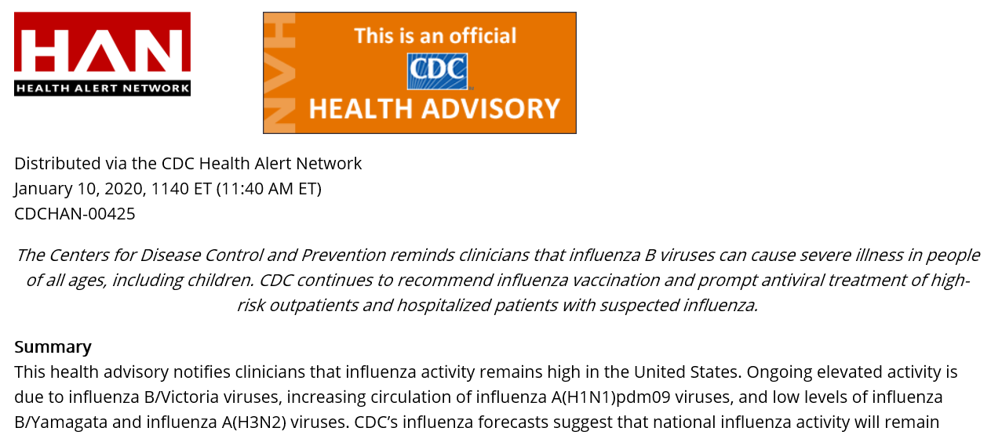
Elevated Influenza Activity: Influenza B/Victoria and A(H1N1)pdm09 Viruses are the Predominant Viruses

Slide 34
Influenza B Viruses
Among hospitalized adults with confirmed influenza in the United States over 8 seasons
No difference in ICU admission, length of stay, or mortality between influenza A and B infections
Among children in the United States
The proportion of influenza-related pediatric deaths associated with influenza B viruses has generally been higher than the proportion of influenza B among circulating viruses
Su, et al. Clin Infect Dis 2014;59:252-5; Shang, et al. Pediatrics 2018;141(4); Doyle & Campbell. Curr Opin Pediatr 2019;31:119-126; Tran et al. Pediatrics 2016;138(3)
Notes:
.

Slide 35
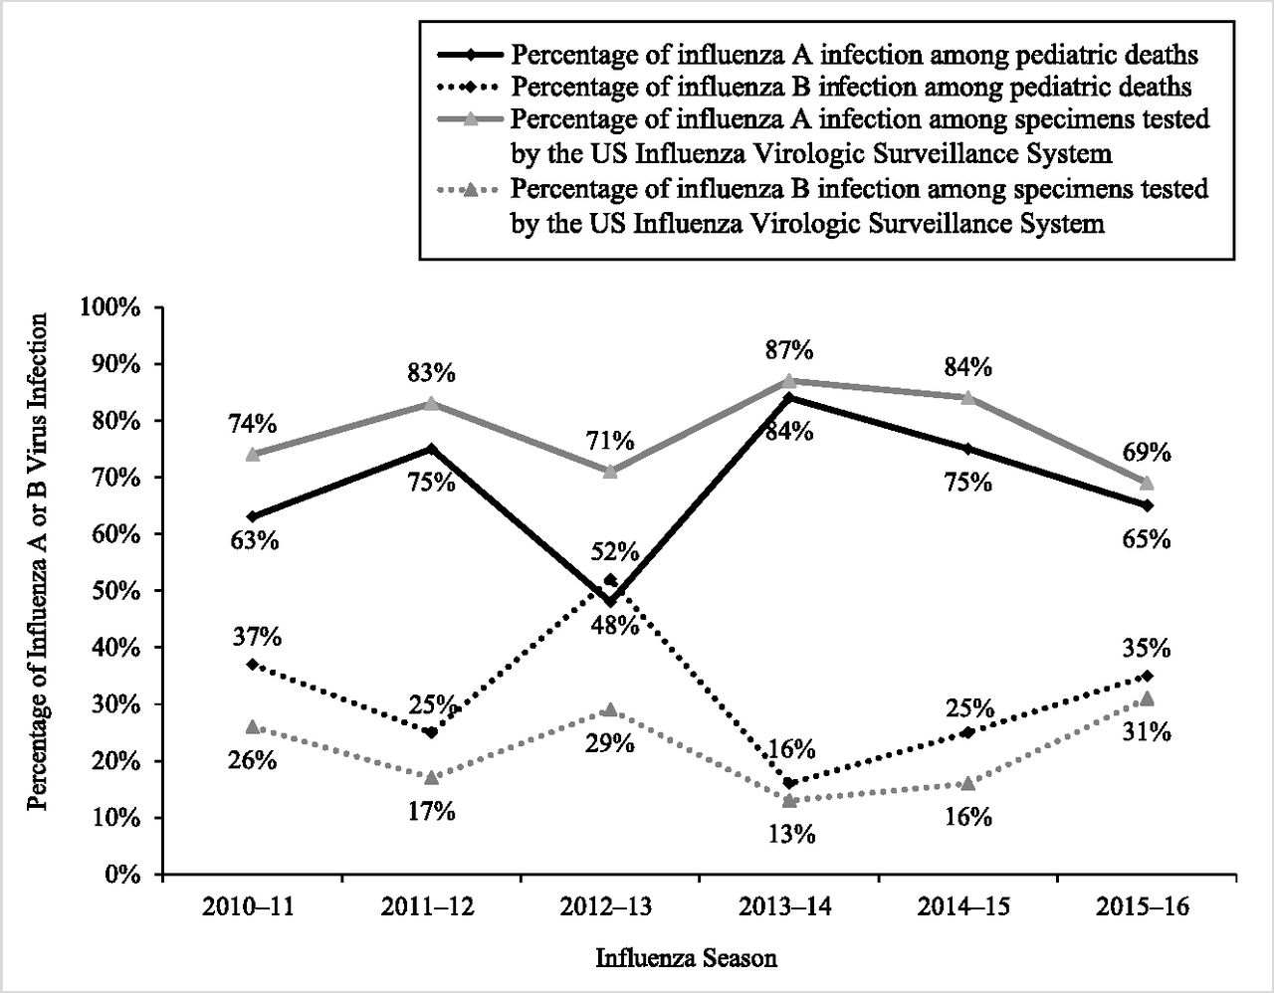
Influenza B Viruses
The proportion of influenza-related pediatric deaths associated with influenza B viruses has generally been higher than the proportion of influenza B among circulating viruses
Shang, et al. Pediatrics 2018;141(4)

Slide 36
Influenza B Viruses
Among hospitalized adults with confirmed influenza in the United States over 8 seasons
No difference in ICU admission, length of stay, or mortality between influenza A and B infections
Among children in the United States
The proportion of influenza-related pediatric deaths associated with influenza B viruses has generally been higher than the proportion of influenza B among circulating viruses
Su, et al. Clin Infect Dis 2014;59:252-5; Shang, et al. Pediatrics 2018;141(4); Doyle & Campbell. Curr Opin Pediatr 2019;31:119-126; Tran et al. Pediatrics 2016;138(3)

Slide 37
Influenza B Viruses
Among hospitalized adults with confirmed influenza in the United States over 8 seasons
No difference in ICU admission, length of stay, or mortality between influenza A and B infections
Among children in the United States
The proportion of influenza-related pediatric deaths associated with influenza B viruses has generally been higher than the proportion of influenza B among circulating viruses
Mortality from influenza B–associated hospitalizations has been reported to be higher than with influenza A–associated hospitalizations
Su, et al. Clin Infect Dis 2014;59:252-5; Shang, et al. Pediatrics 2018;141(4); Doyle & Campbell. Curr Opin Pediatr 2019;31:119-126; Tran et al. Pediatrics 2016;138(3)

Slide 38
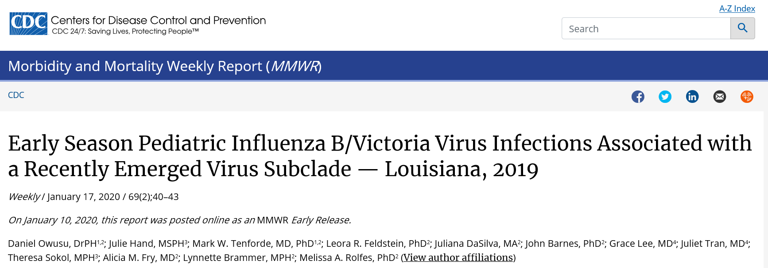
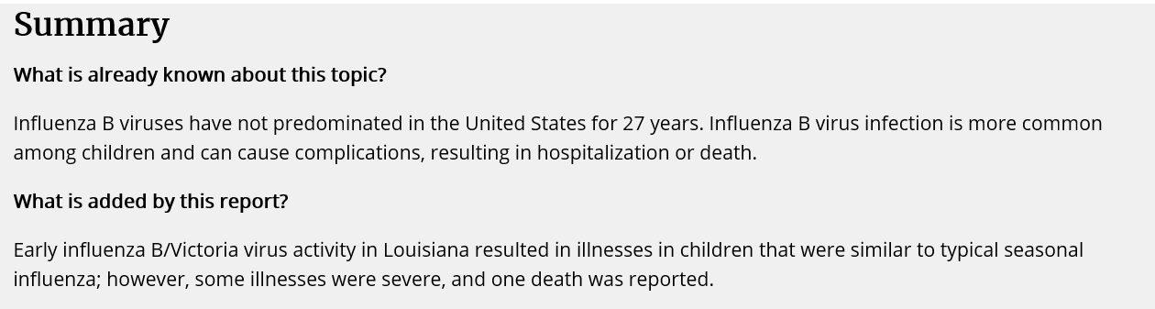
CDC MMWR
Owusu, et al. MMWR 10 Jan 2019

Slide 39
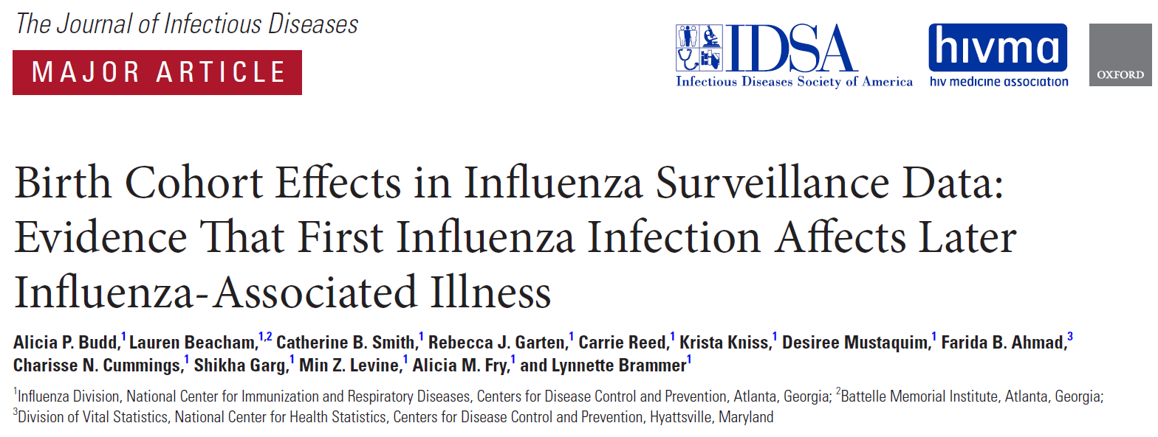
Influenza A(H1N1)pdm09 Viruses
2018 systematic review found weak evidence that A(H1N1)pdm09 viruses were more often associated with secondary bacterial pneumonia, ICU admission, and death in the post-2009 pandemic period
Subsequent analysis suggests that since the pandemic, more severe
Subsequent analysis suggests disease and death occurred during H1 predominant seasons than H3, particularly in adults not originally exposed to currently circulating A(H1N1)pdm09 viruses
Caini, et al. Influenza Other Respir Viruses 2018;12:780-92
Budd, et al. J Infect Dis 2019;220:820-29

Slide 40
Influenza Vaccination and Vaccine Effectiveness

Slide 41

Influenza Vaccination
Influenza vaccination is the best way to protect against influenza
The Advisory Committee on Immunization Practices/CDC recommend annual vaccination for everyone 6 months of age and older who do not have contraindications
Recommended to be received by the end of October
As long as influenza viruses are circulating, vaccination should continue throughout influenza season, even into January or later
Grohskopf, et al. MMWR 2019; 68(No. RR-3): 1-21

Slide 42

2019-20 Influenza Vaccine Composition
Trivalent vaccines:
A/Brisbane/02/2018 (H1N1)pdm09–like virus--updated
A/Kansas/14/2017 (H3N2)–like virus--updated
B/Colorado/06/2017-like virus (Victoria lineage)
Quadrivalent vaccines:
The above three viruses, and
a B/Phuket/3073/2013-like virus (Yamagata lineage)
Grohskopf, et al. MMWR 2019; 68(No. RR-3): 1-21

Slide 43
Communicating Influenza Vaccine Effectiveness is Challenging…
Varies by population, circulating virus, vaccine type
CDC developed a model to translate:
Vaccine effectiveness
Number of influenza-related outcomes
prevented by vaccination
Tokars et al, Vaccine 2018, 36(48): 7331-37

Slide 44
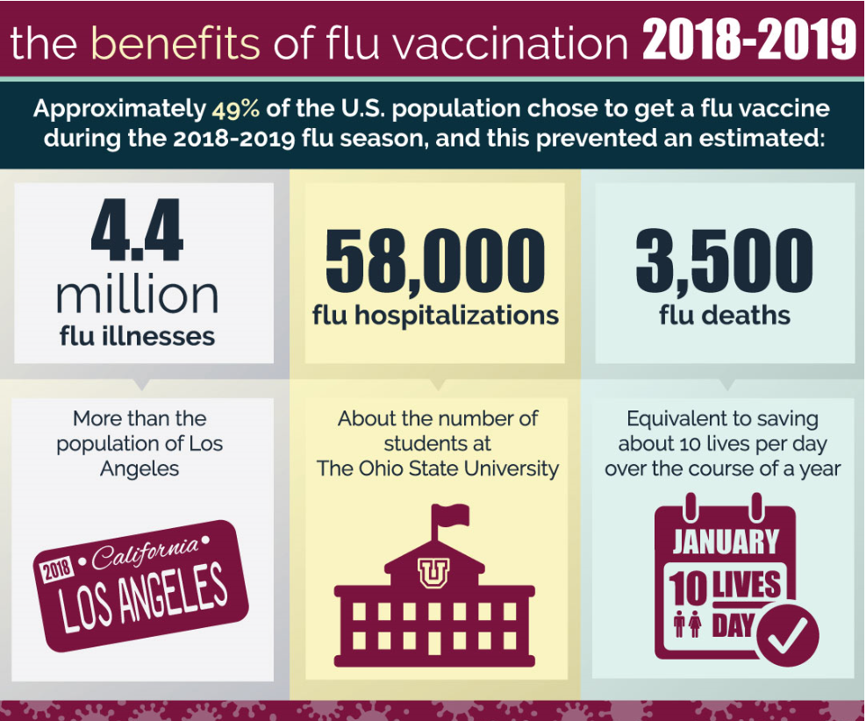
Burden Averted by Influenza Vaccination, 2018-19 Season
https://www.cdc.gov/flu/vaccines-work/burden-averted.htm

Slide 45
Diagnosis of Influenza

Slide 46
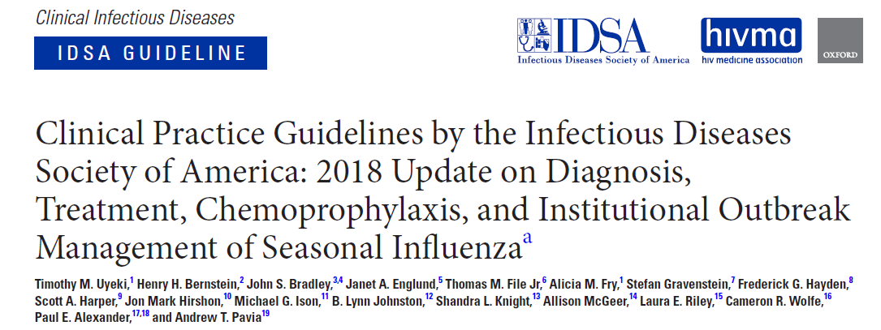
2018 IDSA Clinical Practice Guidelines
Uyeki, et al. Clin Infect Dis 2019;68(6):895-902

Slide 47
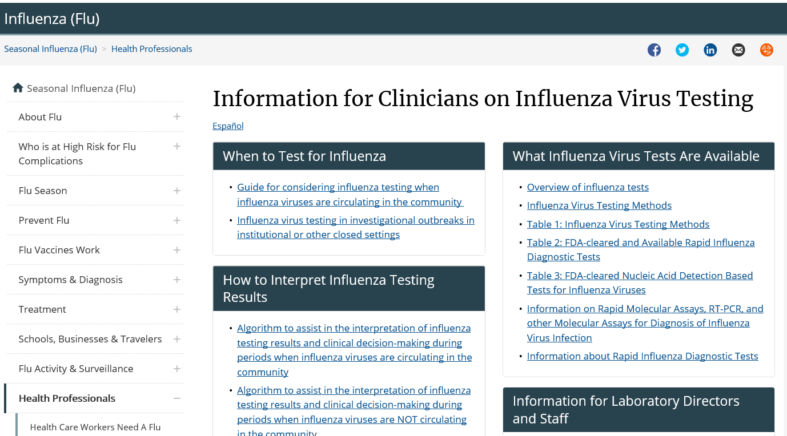
https://www.cdc.gov/flu/professionals/diagnosis/index.htm

Slide 48
Influenza Testing Should be Performed when…
Results are likely to influence clinical management
Decrease unnecessary laboratory testing for other etiologies
Decrease unnecessary use of antibiotics
Facilitate implementation of infection prevention and control measures
Increase appropriate use of influenza antiviral medications
Potentially decrease length of stay
Results will influence a public health response
Outbreak identification and interventions
Uyeki, et al. Clin Infect Dis 2019;68(6):895-902

Slide 49
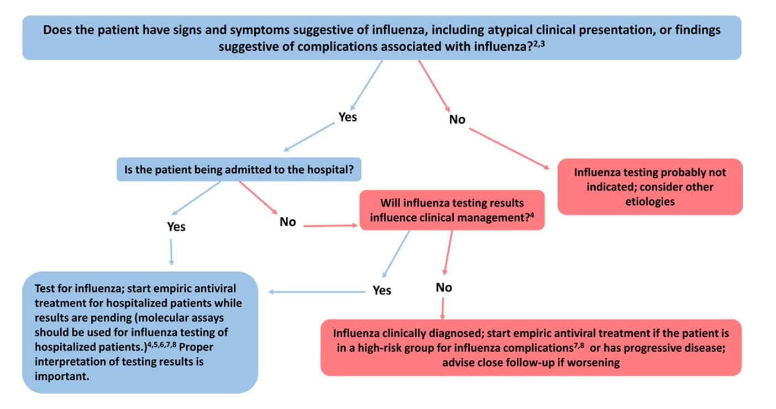
Guide for Considering Influenza Testing when Influenza Circulating in the Community
https://www.cdc.gov/flu/professionals/diagnosis/consider-influenza-testing.htm

Slide 50
What Tests Should be Used to Diagnose Influenza?
Outpatients
Rapid molecular assays (nucleic acid amplification tests) have high sensitivity and will improve detection over rapid influenza diagnostic tests (RIDTs) that use antigen detection
Hospitalized Patients
Molecular assays (including RT-PCR or other multiplex molecular assays) should be used to improve detection of influenza
Multiplex molecular panel recommended for hospitalized immunocompromised patients

Slide 51
Antiviral Treatment Recommendations

Slide 52
Influenza Antiviral Treatment
Influenza antiviral medications are an important adjunct to vaccination
Focus of CDC influenza treatment guidance is on prevention of severe outcomes
Treatment of those with severe disease and persons at highest risk of severe influenza complications
Antiviral recommendations are common to IDSA, AAP, PIDS, ACOG
Uyeki, et al. Clin Infect Dis 2019;68(6):895-902
AAP COID. Pediatrics, 2019;144(4):e20192478
https://www.acog.org/Clinical-Guidance-and-Publications/Committee-Opinions/Immunization-Infectious-Disease-and-Public-Health-Preparedness-Expert-Work-Group/Assessment-and-Treatment-of-Pregnant-Women-With-Suspected-or-Confirmed-Influenza
https://www.cdc.gov/flu/professionals/antivirals/summary-clinicians.htm

Slide 53
Influenza Antiviral Treatment – Brief Overview of Data
Clinical trials and observational data show that early antiviral treatment can shorten the duration of fever and flu symptoms
Meta-analyses of randomized controlled trials have demonstrated that early treatment reduced risk of otitis media in children and lower respiratory tract complications requiring antibiotics and hospital admission in adults
Observational studies and meta-analyses of observational data have reported:
Among high-risk outpatient children and adults, early antiviral treatment reduced risk of hospital admission
Early treatment of hospitalized adult influenza patients with oseltamivir reduced the likelihood of death and shortened hospitalization
In hospitalized children, early antiviral treatment with oseltamivir shortened duration of hospitalization
Muthuri, Lancet Resp Med 2014;2:395-404; Dobson, Lancet 2015; 385(9979):1728; Malosh et al. Clin Infect Diseases 2018; Venkatesan et al. Clin Infect Diseases 2017; Coffin Ped Inf Dis J 2011; Katzen, Clin Infect Diseases 2019

Slide 54

Antiviral Treatment Recommendations
Antiviral treatment is recommended as early as possible for any patient with suspected or confirmed influenza who is:
Hospitalized
Has severe, complicated, or progressive illness
Is at high risk for influenza complications
Uyeki, et al. Clin Infect Dis, 2019;68(6):895-902
https://www.cdc.gov/flu/professionals/antivirals/summary-clinicians.htm

Slide 55

People at High Risk for Influenza Complications for Whom Antiviral Treatment is Recommended
Children <2 years old (although all children <5 years old are considered at high risk for complications, highest risk is for children <2 years old)
Adults age 65 years and over
Pregnant/postpartum women
American Indians/Alaska Natives
Children <18 years old receiving long-term aspirin therapy
People with underlying medical conditions (e.g., pulmonary, cardiac, immunosuppression, neurologic and neurodevelopment conditions)
Residents of nursing homes/chronic care facilities
https://www.cdc.gov/flu/professionals/antivirals/summary-clinicians.htm

Slide 56

Timing of Influenza Antiviral Treatment
Clinical benefit is greatest when antiviral treatment is initiated as close to illness onset as possible
Treatment should not be delayed while testing results are pending
Antiviral treatment initiated after 48 hours can still be beneficial in some patients
Observational studies of hospitalized patients suggest that treatment might still be beneficial when initiated 4 or 5 days after symptom onset
Observational data in pregnant women has shown antiviral treatment to provide benefit when started 3-4 days after onset
https://www.cdc.gov/flu/professionals/antivirals/summary-clinicians.htm
Muthuri, Lancet Resp Med 2014;2:395-404; Louie, CID 2012;55:1198-204; Yu, CID 2011;52:457-65; Siston, JAMA 2010;303:1517-25

Slide 57
Antiviral Treatment Recommendations
Antiviral treatment is recommended as early as possible for any patient with suspected or confirmed influenza who is:
Hospitalized
Has severe, complicated, or progressive illness
Is at high risk for influenza complications
Uyeki, et al. Clin Infect Dis, 2019;68(6):895-902
https://www.cdc.gov/flu/professionals/antivirals/summary-clinicians.htm

Slide 58
Antiviral Treatment Recommendations
Antiviral treatment is recommended as early as possible for any patient with suspected or confirmed influenza who is:
Hospitalized
Has severe, complicated, or progressive illness
Is at high risk for influenza complications
Antiviral treatment can be considered for any previously healthy, symptomatic outpatient not at high risk with suspected or confirmed influenza on the basis of clinical judgment, if treatment can be initiated within 48 hours of illness onset
Uyeki, et al. Clin Infect Dis, 2019;68(6):895-902
https://www.cdc.gov/flu/professionals/antivirals/summary-clinicians.htm

Slide 59
Influenza Antiviral Medications
Four FDA-approved antivirals are recommended for use in the United States
Drug | Route | Treatment | Treatment Course | Chemo-prophylaxis | Adverse Events
Oseltamivir | Oral | Any age | 1 dose twice daily x 5 days | >3 months | Nausea, vomiting, headache^*
Zanamivir | Inhaled | >7 years | 1 dose twice daily x 5 days | >5 years | Bronchospasm*
Peramivir | Intravenous | >2 years | 1 dose | N/A | Diarrhea*
Baloxavir** | Oral | >12 years | 1 dose | N/A | None more common than placebo
^Nausea and vomiting are generally transient and can be mitigated if oseltamivir is taken with food *Post-marketing reports of serious skin reactions and sporadic, transient neuropsychiatric events **The safety and efficacy of baloxavir for the treatment of influenza have been established in pediatric patients >12 years and weighing at least 40 kg.
https://www.cdc.gov/flu/professionals/antivirals/summary-clinicians.htm

Slide 60
Influenza Antiviral Medications: Background
Neuraminidase inhibitors: oseltamivir, zanamivir, peramivir
FDA approved for treatment of acute, uncomplicated influenza
Cap-dependent endonuclease inhibitor: baloxavir (oral)
Interferes with viral RNA transcription and blocks viral replication
FDA approved Dec 2018, for treatment of acute, uncomplicated influenza
In Oct 2019, FDA approved indication for baloxavir treatment of acute uncomplicated influenza in people at high risk of influenza-related complications
In trial of early initiation of antiviral treatment for uncomplicated influenza in high-risk adolescents and adults, baloxavir was superior to placebo and had similar overall efficacy to oseltamivir in the time to alleviation of symptoms
No available data for baloxavir treatment of influenza in pregnant women, immunocompromised people, those with severe disease, or hospitalized patients
https://www.cdc.gov/flu/professionals/antivirals/summary-clinicians.htm

Slide 61

Influenza Antiviral Treatment: Hospitalized Patients
Treatment with oral or enterically-administered oseltamivir is recommended as soon as possible
There are insufficient data for use of inhaled zanamivir, intravenous peramivir, and oral baloxavir in patients with severe influenza disease
For patients who cannot tolerate or absorb oral or enterically-administered oseltamivir (gastric stasis, malabsorption, or gastrointestinal bleeding), the use of intravenous peramivir should be considered
The optimal duration and dosing of antiviral treatment are uncertain for severe or complicated influenza
Image by Gan Khoon Lay from the Noun Project
https://www.cdc.gov/flu/professionals/antivirals/summary-clinicians.htm

Slide 62

Influenza Antiviral Treatment: Pregnant Women
For treatment of pregnant women or women who are up to 2 weeks postpartum, oral oseltamivir is preferred because it has the most studies available to suggest that it is safe and beneficial
Baloxavir is not recommended for treatment of pregnant women or breastfeeding mothers
No available efficacy or safety data in pregnant women
No available data on the presence of baloxavir in human milk, the effects on the breastfed infant, or the effects on milk production
Image by Gan Khoon Lay from the Noun Project
https://www.cdc.gov/flu/professionals/antivirals/summary-clinicians.htm

Slide 63
Influenza Treatment: Additional Considerations
Bacterial Coinfection
Investigate and empirically treat in patients with suspected or confirmed influenza who present initially with severe disease (extensive pneumonia, respiratory failure, hypotension, and fever), in addition to antiviral treatment
Investigate and empirically treat in patients who deteriorate after initial improvement, particularly in those treated with antivirals
Consider investigating bacterial coinfection in patients who fail to improve after 3–5 days of antiviral treatment
Corticosteroids
Not recommended as adjunctive therapy for suspected or confirmed influenza, influenza-associated pneumonia, respiratory failure, or ARDS, unless clinically indicated for other reasons
Uyeki, et al. Clin Infect Dis, 2019;68(6):895-902
Metlay, et al. Am J Respir Crit Care Med 2019;200(7):e45-67

Slide 64

Additional CDC Resources
CDC Influenza homepage: https://www.cdc.gov/flu/
Influenza surveillance (FluView and FluView Interactive):
https://www.cdc.gov/flu/weekly/fluactivitysurv.htm
https://www.cdc.gov/flu/weekly/fluviewinteractive.htm
For Professionals:
https://www.cdc.gov/flu/professionals/index.htm
2019-20 ACIP Influenza Recommendations: https://www.cdc.gov/mmwr/volumes/68/rr/rr6803a1.htm
Vaccination homepage: https://www.cdc.gov/flu/professionals/vaccination/index.htm
Antiviral homepage: https://www.cdc.gov/flu/professionals/antivirals/index.htm

Slide 65
To Ask a Question
Using the Webinar System
Click on the Q&A button in the Zoom webinar system.
Type your question in the Q&A box.
Submit your question.
Please do not submit a question using the chat button.
For media questions, please contact CDC Media Relations at
404-639-3286 or send an email to media@cdc.gov.
If you are a patient, please refer your questions to your healthcare provider.

Slide 66
Today’s Webinar Will Be Available On-Demand
When: A few days after the live call
What: Video with closed captioning
Where: On the COCA Call webpage at
https://emergency.cdc.gov/coca/calls/2019/callinfo_012020.asp

Slide 67
Continuing Education
All continuing education for COCA Calls are issued online through the CDC Training & Continuing Education Online system at https://tceols.cdc.gov/
Those who participated in today’s COCA Call and who wish to receive continuing education should complete the online evaluation by March 2, 2020, with the course code WC2922. The access code is COCA012820. Those who will participate in the on demand activity and wish to receive continuing education should complete the online evaluation between March 2, 2020, and March 3, 2022, and use course code WD2922. The access code is COCA012820.
Continuing education certificates can be printed immediately upon completion of your online evaluation. A cumulative transcript of all CDC/ATSDR CEs obtained through the CDC Training & Continuing Education Online System will be maintained for each user.

Slide 68
Two Upcoming COCA Calls This Week
Topic: HHS Guide for Clinicians on the Appropriate Dosage Reduction or Discontinuation of Long-Term Opioid Analgesics
Date: Thursday, January 30, 2020 Time: 2:00-3:00 PM EST
*For further information, please visit: https://emergency.cdc.gov/coca/calls/2020/callinfo_013020.asp
Topic: Outbreak of 2019 Novel Coronavirus (2019-nCoV)—Interim Guidance for Clinicians
Date: Friday, January 31, 2020
Time: 2:00-3:00 PM EST
*For further information, please visit: https://emergency.cdc.gov/coca/calls/2020/callinfo_013120.asp

Slide 69



COCA Products & Services
COCA Call Announcements contain all information subscribers need to participate in COCA Calls. COCA CallCOCA Call Announcements contain all information subscribers need to participate in COCA Calls. COCA Calls are held as needed.
s are held as needed.
COCA Call Announcements contain all information subscribers need to participate in COCA Calls. COCA Calls are held as needed.
Monthly newsletter that provides information on CDC training opportunities, conference and training resources, the COCA Partner Spotlight, and the Clinician Corner.
As-needed messages that provide specific, immediate action clinicians should take. Contains comprehensive CDC guidance so clinicians can easily follow recommended actions.

Slide 70



COCA Products & Services
Monthly newsletter that provides updates on emergency preparedness and response topics, emerging public health threat literature, resources for health professionals, and additional information important during public health emergencies and disasters.
Informs clinicians of new CDC resources and guidance related to emergency preparedness and response. This email is sent as soon as possible after CDC publishes new content.
CDC's primary method of sharing information about urgent public health incidents with public information officers; federal, state, territorial, and local public health practitioners; clinicians; and public health laboratories.

Slide 71

Join COCA’s Mailing List
Receive information about:
Upcoming COCA Calls
Health Alert Network (HAN) messages
CDC emergency response activations
Emerging public health threats
Emergency preparedness and response conferences and training opportunities
http://emergency.cdc.gov/coca

Slide 72


Join Us on Facebook

Slide 73

Thank you for joining us today!
http://emergency.cdc.gov/coca

